Slide 1

Device Vision
Harshit Kumar V
Eswar Saravanan Kumar
Manudev Rethinakumar
Giriharan Ravichandran
Sudeep Aryan

Slide 2
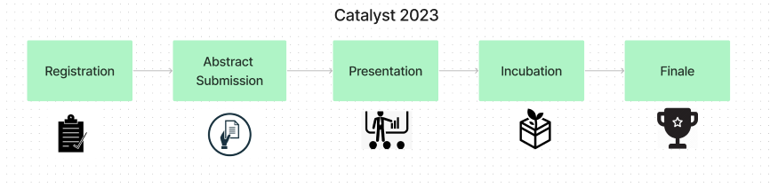
Finale Time Duration
Final Presentation - 12 minutes
Live Demo - 8 minutes
Questions on the offering - 5 minutes
TOTAL PRESENTATION TIME - 25 minutes
You're here

Slide 3


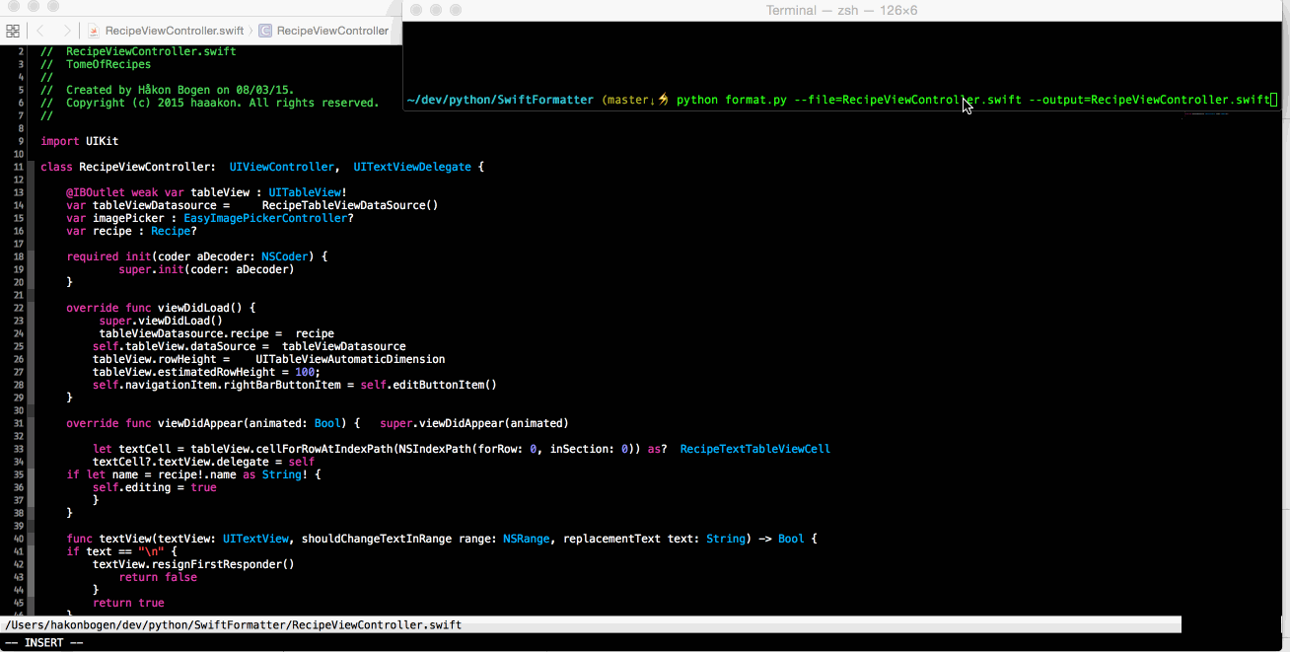
Problem Statement
Domain Expertise
Data analysis
Manual scripts creation
Notes:
Software expertise to analyse data​
Consolidating observations and data points based on testing/validation data collected​
Manual creation of software scripts to analyse data​

Slide 4



Idea
Device vision is a Data analysis tool designed to validate data and Identify different data patterns derived from various electronics devices and circuits.
DV reduces time, capital and expertise required for the validation engineers to analyse electronic data.
Notes:
Short Description on DV – max 2 sentences
Add Images

Slide 5


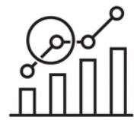





Solution
A locally Hosted GUI
Pre-Defined Data for Analyzing
Visualization
Prediction
Report Generation
Common platform
APIs for Automation
Create custom formulae
Notes:
A web-based GUI or desktop GUI,
To create custom formulae for data analysis with minimal software expertise
Creation, reuse and sharing of formulae/data patterns
Report generation of analyzed data by the GUI

Slide 6
Solution
A locally hosted GUI
Create custom formulae for data analysis
Visualization and Report generation
Common platform to discuss the analysis
APIs to integrate with other tools for automation
Notes:
A web-based GUI or desktop GUI,
To create custom formulae for data analysis with minimal software expertise
Creation, reuse and sharing of formulae/data patterns
Report generation of analyzed data by the GUI

Slide 7


Demo Features
Storing and Viewing the Generated Results
Data Analysis ( using available pre-defined models )
Visualization of Validation data / curves
Error Analysis
Inspection of the Waveform

Slide 8
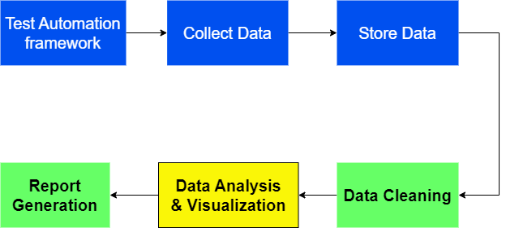
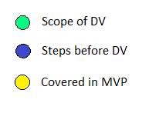
Typical workflow of Validation Engineer
Soliton Technologies Confidential
8
Notes:
G - Scope of DV
B – Steps before DV

Slide 9

Notes:
Add future scope after this slide

Slide 10


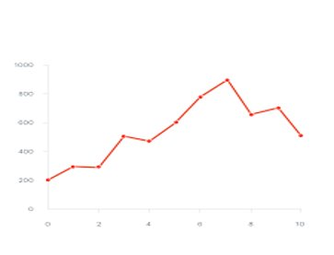

Future Scope
Report Generation
Graph Prediction
Common dashboard for collaboration
Custom formulae creation
Additional Pre-defined models / analyses
Automation APIs

Slide 11

Why should we invest in this further?
Current state
Has one complete workflow
Need more time to convert this into a MVP(3 months)
Major blockers
Need actual data to train our models
Need better understanding of the domain and other workflow possibilities

Slide 12

Why should we invest in this further?
Game plan
Create tailored versions of DV for relevant teams and let them use.
This would act as a gateway to understand new possibilities and workflows.
This makes us understand the domain better.
Value added to soliton
Once DV has evolved to a good state, it can be integrated with the existing tools that soliton builds for validation engineers

Slide 13



Learnings during the Incubation
Operation side
Code Optimization in Web Frameworks
Error Handling
Coding standards and formats
Advanced Techniques in Web Tech to solve a problem
Main concepts of DB
Core concept of Machine Learning
Generating models.
Applied DevOps tools.
Notes:
Add all the Learnings

Slide 14

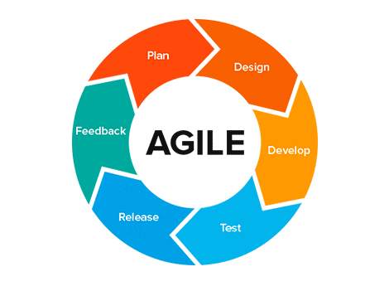

Learnings during the Incubation
Process side
Effective Time Management
Agile Process
Team Coordination and management
Feedbacks
Project Management
Real time project Experience
Problem Solving

Slide 15

Questions

